Slide 1
Submitting CTR Report – Scenario 1
Mr. Kamal Sahan Gamage visit Gampaha branch of Test Finance Company and deposit 5Mn to his own account (Acc. Num LFC_ACC111) on 10/08/2023
Kamal Sahan Gamage
Account in LFC
– LFC_ACC111

Slide 2
First check in reporting model

Slide 3
Transaction Details
Transaction Details | Transaction 1
Transaction Number | TX001
Transaction Mode | Branch
Local Amount (LKR) | 5,000,000
Date | 10/08/2023
Transaction Location | Gampaha
Nature of Transaction | Cash Deposit to his own account – CA1

Slide 4
From Party – ***
This is a Bi Party Transaction
To Party – ***
Funds Code : ***
Funds Code : ***
Person Details | Person (My Client)
First Name | Kamal Sahan
Last Name | GAMAGE
Birthdate | 01/05/1980
NIC Number | 800123456V
Nationality | Sri Lanka
Residence | Sri Lanka
Occupation | Driver
Address Type | Private
Address | 11, Samagi Mawatha, Rajagiriya
Address District | Colombo
Address Country | Sri Lanka
Account Details | Account (My Client)
Account Number | LFC_ACC111
Acc Holding Institution | Test Finance Company
SWIFT/LankaCLear/LankaFIN Code | TSTBLKXX
Branch | Gampaha
Type | Savings
Status | Active
Currency | LKR
[Account Own] Signatory(ies) | Person - 800123456V (reuse) Role: Account Holder

Slide 5
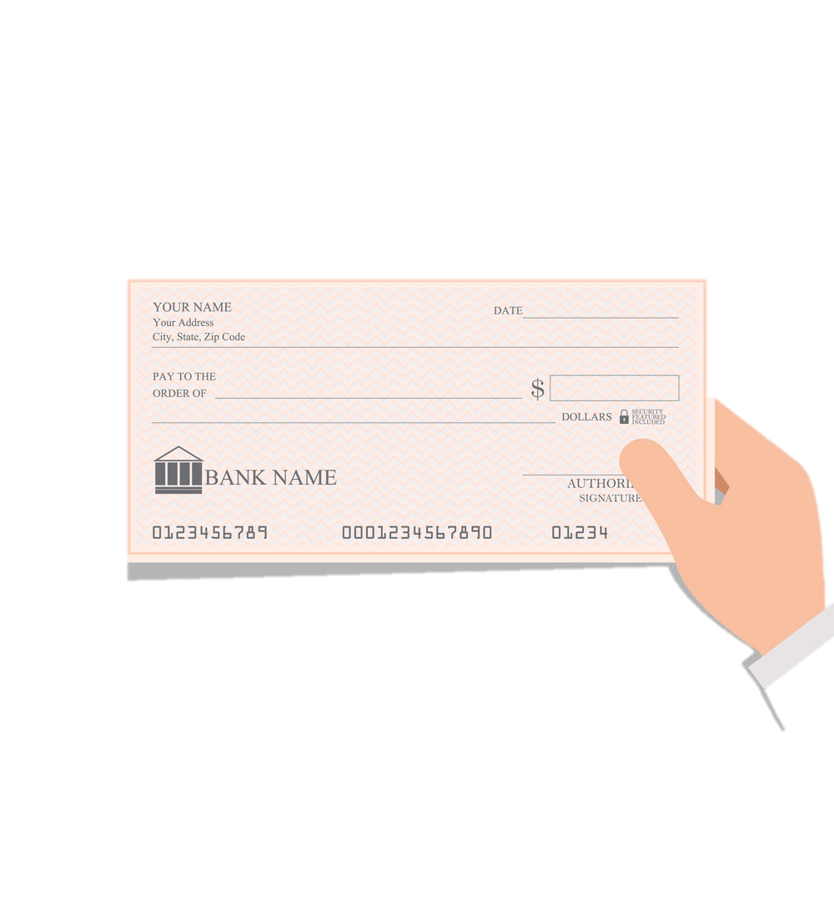
Submitting CTR Report – Scenario 2
Mr. Kamal Sahan Gamage has an account (Acc. Num LFC_ACC111) in Test Finance Company. On 10/10/2022, He withdraws LKR 1Mn from collection account of the LFC (Acc. Num COL_ACC100) by presenting a cheque issued by the LFC (cash cheque)
Account in LFC
– LFC_ACC111
Kamal Sahan Gamage
Collection Account
– COL_ACC100

Slide 6
First check in reporting model

Slide 7
Transaction Details
Transaction Details | Transaction 1
Transaction Number | TX002
Transaction Mode | Back Office
Local Amount (LKR) | 5,000,000
Date | 10/10/2022
Nature of Transaction | Cash withdrawn via a cheque – CA2

Slide 8
From Party – ***
This is a Bi Party Transaction
To Party – ***
Funds Code : ***
Funds Code : ***
Account Details | Account (My Client)
Account Number | LFC_ACC111
Acc Holding Institution | Test Finance Company
SWIFT/LankaCLear/LankaFIN Code | TSTBLKXX
Branch | Borella
Type | Savings
Status | Active
Currency | LKR
[Account Own] Signatory(ies) | Person - 800123456V (reuse) Role: Account Holder
Person Details | Person (My Client)
First Name | Kamal Sahan
Last Name | GAMAGE
Birthdate | 01/05/1980
NIC Number | 800123456V
Nationality | Sri Lanka
Residence | Sri Lanka
Occupation | Driver
Address Type | Private
Address | 11, Samagi Mawatha, Rajagiriya
Address District | Colombo
Address Country | Sri Lanka

Slide 9
Submitting CTR Report – Scenario 3
On August 10, 2023, Mr. Kamal Sahan Gamage visited the Gampaha branch of Test Finance Company, and he deposited LKR 500,000. Additionally, he transferred LKR 500,000 from his personal account (Acc No. PER_ACC200) to the collection account of LFC (Acc No. COL_ACC100). Both transfers were aggregately considered for the process of opening an new account with LFC (Acc No. LFC_ACC_111)
Cash Transfer – 300,000
Account in LFC
– LFC_ACC111
Mr. Kamal Sahan Gamage
1,000,000 for Account Opening
Collection Account
– COL_ACC100
Electronic – 700,000
Customer’s personal account in Test Bank Limited
PER_ACC200

Slide 10
First check in reporting model

Slide 11
Transaction Details
Transaction Details | Transaction 1
Transaction Number | TX003
Transaction Mode | Branch
Local Amount (LKR) | 2,000,000
Date | 08/10/2022
Transaction Location | Gampaha
Nature of Transaction | Cash deposit LKR 500,000 and Electronic Fund Transfer LKR 500,000 to open a account – CA1,CA4

Slide 12
From Party – ***
This is a Bi Party Transaction
To Party – ***
Funds Code : ***
Funds Code : ***
Person Details | Person (My Client)
First Name | Kamal Sahan
Last Name | GAMAGE
Birthdate | 01/05/1980
NIC Number | 800123456V
Nationality | Sri Lanka
Residence | Sri Lanka
Occupation | Driver
Address Type | Private
Address | 11, Samagi Mawatha, Rajagiriya
Address District | Colombo
Address Country | Sri Lanka
Account Details | Account (My Client)
Account Number | LFC_ACC111
Acc Holding Institution | Test Finance Company
SWIFT/LankaCLear/LankaFIN Code | TSTBLKXX
Branch | Gampaha
Type | Savings
Status | Active
Currency | LKR
[Account Own] Signatory(ies) | Person - 800123456V (reuse) Role: Account Holder

Slide 13
Submitting EFT Report – Scenario 4
Silver (pvt) ltd holds an account in Test Finance Company (Acc. No: LFC_ACC222). The director of Silver (pvt) ltd was provided an account payee withdrawal cheque that was issued by Test Finance Company & by presenting the cheque, the director has withdrawn funds from the collection account (Acc. No: COL_ACC100) of the LFC to Silver (pvt) ltd’s current account (Account No: ENT_ACC200). Silver (pvt) ltd has only two directors named Nimal Withana & Jagath Perera. Cheque amount is 1,200,000 LKR
Entity’s current account in Test Bank Limited
ENT_ACC200
Account operated in LFC : LFC_ACC222
Collection account at Test Bank Limited COL_ACC100

Slide 14
First check in reporting model

Slide 15
Transaction Details
Transaction Details | Transaction 1
Transaction Number | TX004
Transaction Mode | Back Office
Local Amount (LKR) | 1,200,000
Date | 02/04/2023
Nature of Transaction | Cash withdrawn via a cheque – CA3

Slide 16
From Party – ***
This is a Bi Party Transaction
To Party - ***
Funds Code : ***
Funds Code : ***
Entity Details | Entity (My Client)
Name | Silver (pvt) limited
Incorporation Legal form | Private Limited Company
Incorporation Number | PV002
Business Category | Vehicle Buy and Sell
Address Type | Business
Address | 12, Sea Street, Galle
Address District | Galle
Address Country | Sri Lanka
Account Details | Account (My Client)
Account Number | LFC_ACC222
Acc Holding Institution | Test Finance Company
SWIFT/LankaCLear/LankaFIN Code | TSTBLKXX
Branch | Galle
Type | Current
Status | Active
Currency | LKR
Ownership | ENTITY
Account Details | Account (My Client)
Account Number | COL_ACC100
Acc Holding Institution | Test Bank Limited
SWIFT/LankaCLear/LankaFIN Code | TSTBLKXX
Details | Director 1 | Director 2
Role | Director | Director
First Name | Jagath | James
Last Name | PERERA | SMITH
NIC | 675466546V
Passport |  | N123456
Nationality | Sri Lanka | USA

Slide 17
Submitting EFT Report – Scenario 5
Mr. Kamal Sahan Gamage has a savings account (Acc. Num LFC_ACC111) in Test Finance Company (Borella Branch) using mobile app he transfer LKR 1,000,000 to Mr & Mrs Silva’s (Amal Silva / Amali Silva) account (Acc. Num LFC_ACC222) which is also an account of Test Finance Company (Matara Branch). Transaction date is 10/08/2023.
(Acc. Num LFC_ACC111)
(Acc. Num LFC_ACC222)

Slide 18
First check in reporting model

Slide 19
Transaction Details
Transaction Details | Transaction 1
Transaction Number | TX005
Transaction Mode | Back Office
Local Amount (LKR) | 1,000,000
Date | 10/08/2023
Nature of Transaction | Account to account transfer inside LFC – FTD1

Slide 20
From Party – ***
This is a Bi Party Transaction
To Party – ***
Funds Code : ***
Funds Code : ***
Account Details | Account (My Client)
Account Number | LFC_ACC111
Acc Holding Institution | Test Finance Company
SWIFT/LankaCLear/LankaFIN Code | TSTBLKXX
Branch | Borella
Type | Savings
Status | Active
Currency | LKR
[Account Own] Signatory(ies) | Person - 800123456V Role: Account Holder
Owner Details | Person (My Client)
First Name | Kamal Sahan
Last Name | GAMAGE
Birthdate | 01/05/1980
NIC Number | 800123456V
Nationality | Sri Lanka
Residence | Sri Lanka
Occupation | Driver
Address Type | Private
Address | 11, Samagi Mawatha, Rajagiriya
Address District | Colombo
Address Country | Sri Lanka
Account Details | Account (My Client)
Account Number | LFC_ACC222
Acc Holding Institution | Test Finance Company
SWIFT/LankaCLear/LankaFIN Code | TSTBLKXX
Branch | Matara
Type | Savings
Status | Active
Currency | LKR
[Account Own] Signatory(ies) | Person - 903546634V/ 923457764V Role: Account Holders
Owner Details | Person 1 (My Client) | Person 2 (My Client)
First Name | Amal | Amali
Last Name | SILVA | SILVA
Birthdate | 01/01/1990 | 02/02/1992
NIC Number | 903546634V | 923457764V
Nationality | Sri Lanka | Sri Lanka
Residence | Sri Lanka | Sri Lanka
Occupation | Businessman – Import & sell Vehicle spare parts | Teacher-ABC School
Address Type | Private | Private
Address | 80, Main Road, Gampola | 80, Main Road, Gampola
Address District | Kandy | Kandy
Address Country | Sri Lanka | Sri Lanka

Slide 21
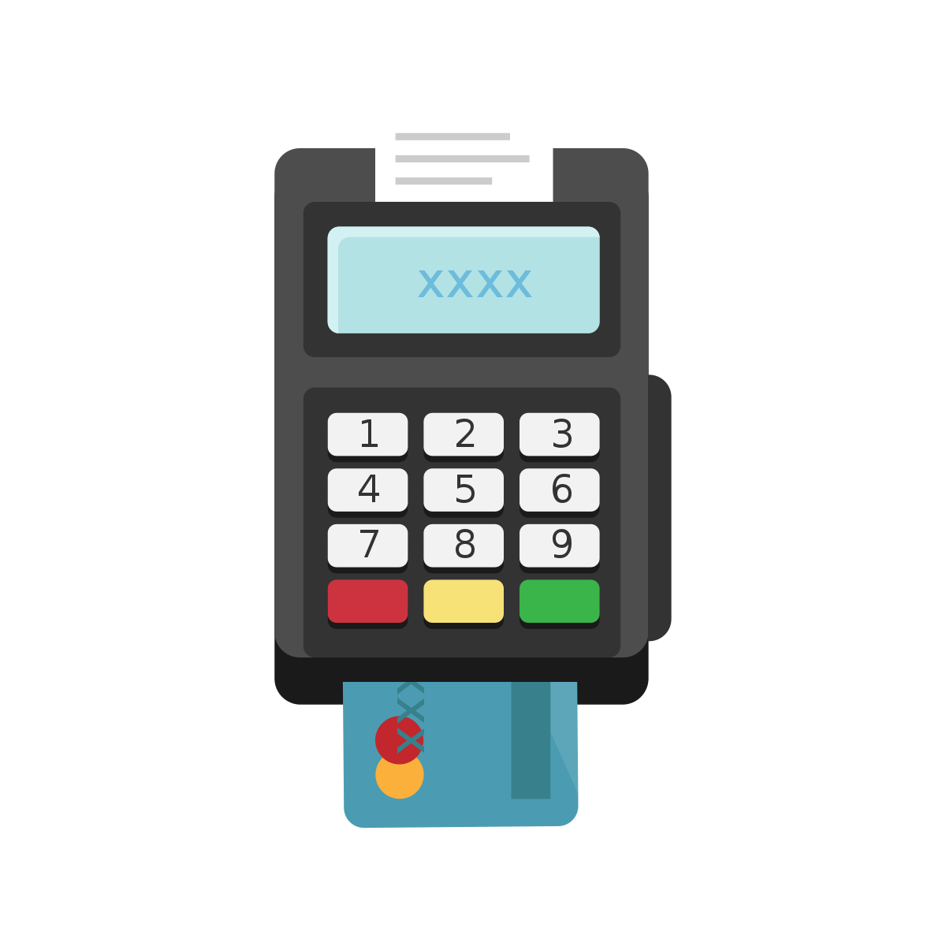
Submitting EFT Report – Scenario 6
Mr. Kamal Sahan Gamage holds a credit card for his savings account (Acc. No: LFC_ACC111) at Test Finance Company, at the Borella Branch. Utilizing this credit card, he recently made a payment totaling LKR 1,500,000 to a local website named buy.lk on the date of December 12, 2022
Account in LFC – LFC_ACC111
Merchant Account - Unknown

Slide 22
First check in reporting model

Slide 23
Transaction Details
Transaction Details
Transaction Number | TX006
Transaction Mode | IPG
Local Amount (LKR) | 1,500,000
Date | 12/12/2022
Transaction Location | Buy.lk
Nature of Transaction | Customer conducted a transaction for buy.lk, making a purchase valued at 1.5 LKR – ONLP1.

Slide 24
This is a Multi Party Transaction
Involved Party – ***
Funds Code : ***
Role : ***
Country : Sri Lanka
Account Details | Account (My Client)
Account Number | LFC_ACC111
Acc Holding Institution | Test Finance Company
SWIFT/LankaClear/LankaFIN Code | TSTBLKXX
Branch | Borella
Type | Savings
Status | Active
Currency | LKR
[Account Own] Signatory(ies) | Person - 800123456V Role: Account Holder
Person Details | Person (My Client)
First Name | Kamal Sahan
Last Name | GAMAGE
Birthdate | 01/05/1980
NIC Number | 800123456V
Nationality | Sri Lanka
Residence | Sri Lanka
Occupation | Driver
Address Type | Private
Address | 11, Samagi Mawatha, Rajagiriya
Address District | Colombo
Address Country | Sri Lanka

